Slide 1

CLOUD
POWERED
KARAOKE
ROB SPECTRE
@dN0t

Slide 2

LET US SPEAK OF
THE CLOUDS

Slide 3

TO MAKE RAIN, JUST ADD
VIRTUALIZATION

Slide 4
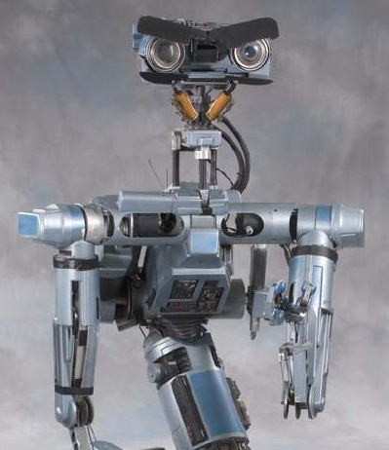
TO MAKE RAIN, JUST ADD
PROGRAMMATIC ACCESS

Slide 5
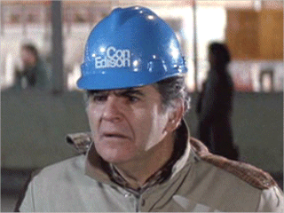
TO MAKE RAIN, JUST ADD
UTILITY PRICING

Slide 6
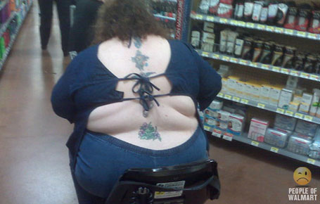
ELASTIC COMPUTING
STRETCHES WITH YOU

Slide 7

AUTOMATIC
REPLAY

Slide 8
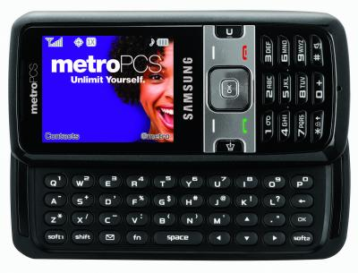
UNLIMIT
YOUR TEENAGER

Slide 9
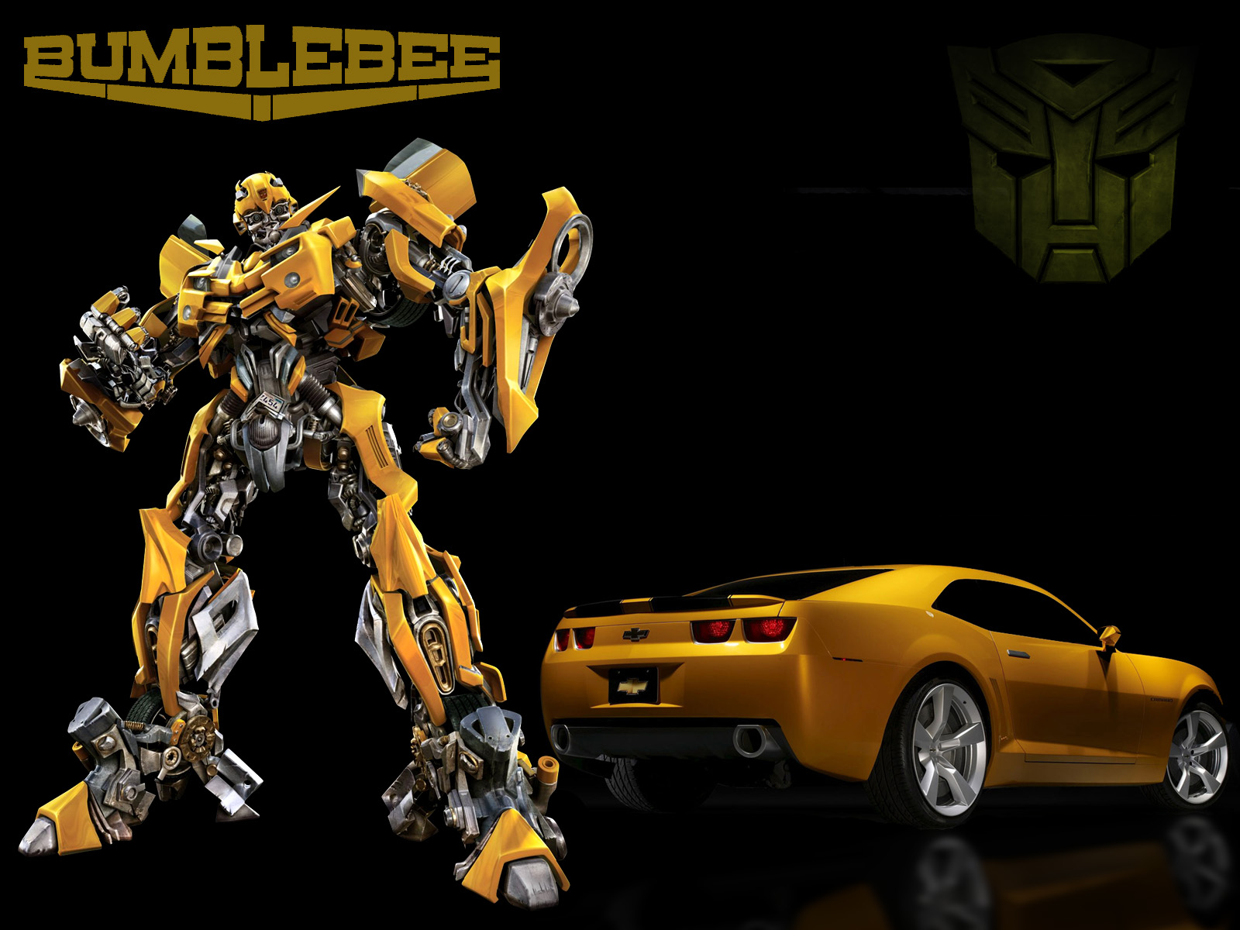
STOP ROBBING MY
CHILDHOOD MICHAEL BAY

Slide 10

SERIOUS
BUSINESS

Slide 11

SERIOUS
BUSINESS

Slide 12

NICE WORK IF YOU
CAN GET IT

Slide 13

MAYBE THEY CAN AFFORD
BIGGER JEANS

Slide 14

YOU KNOW WHAT'S
COOL?

Slide 15
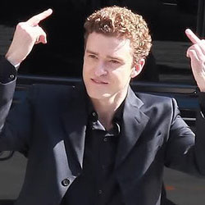
JUSTIN TIMBERLAKE
IS COOL

Slide 16
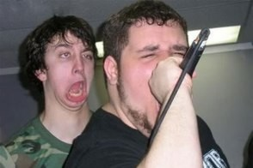
KARAOKE
IS COOL

Slide 17
GITHUB.COM/RobSpectre/Twilio-Karaoke
@dN0t
RSPECTRE @TWILIO.COM
BROOKLYNHACKER.COM

Slide 18
THANK
YOU!

